Slide 1
CHAPTER 9
Engineering
Alloys

Slide 2
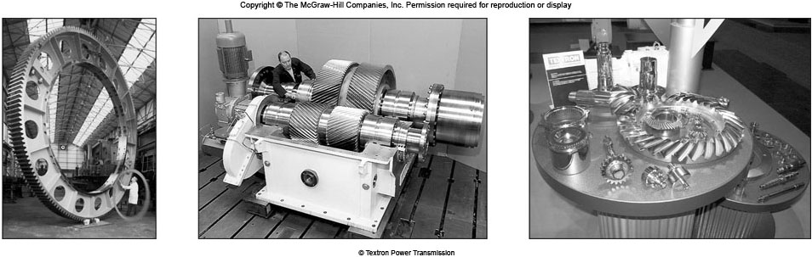
Gears of Various Sizes
普通碳鋼或粗碳鋼
Plain carbon steels, alloy steels, stainless steels, cast iron, and copper alloys are used in manufacturing various gears.
Cr steels: automobile transmission gears, Cr-Mo steels: aircraft gas turbine gears, Ni-Mo steels: earth moving equipment, Cu alloys: low load gears.
土方設備

Slide 3
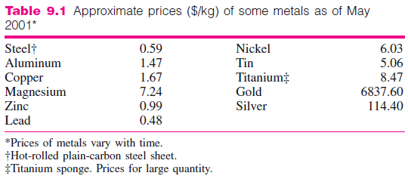
Introduction
金屬材料分鐵合金與非鐵合金，廣用於工程設計，其中鋼鐵佔90％，因具低價、高強度、高韌性優點

Slide 4
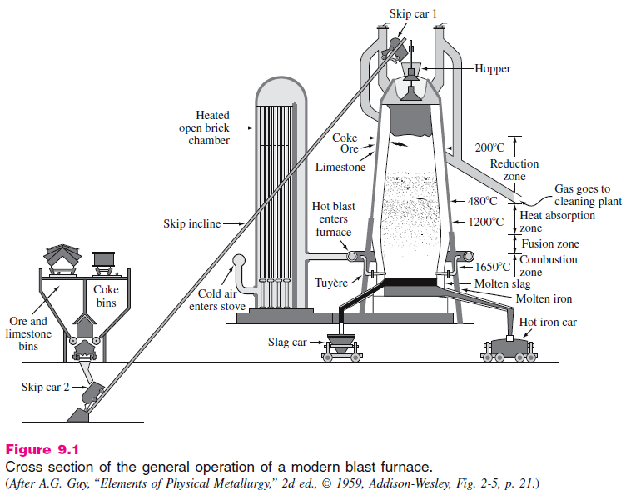
Production of Iron and Steel
Production of pig iron 高爐煉生鐵

Slide 5
Production of Iron and Steel
Production of pig iron
Fe₂O₃ + 3CO → 2Fe + 3CO₂
Ore
Coke
Pig iron
(Liquid)
Blast Furnace
• 煉鋼：Pig iron and 30% steel crap is fed into refractory furnace to which oxygen lance is inserted.
Oxygen reacts with liquid bath to form iron oxide.
FeO + C → Fe + CO
• Slag熔渣 forming fluxes助熔劑 are added.

Slide 6
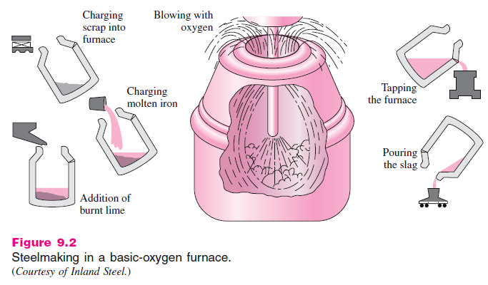
Carbon content and other impurities are lowered. Molten steel is continuously cast and formed into shapes.
轉爐煉鋼

Slide 7
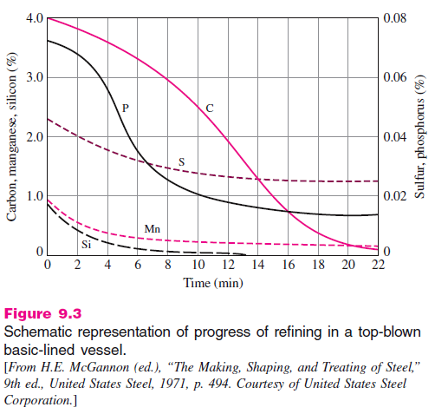
轉爐煉鋼純化

Slide 8
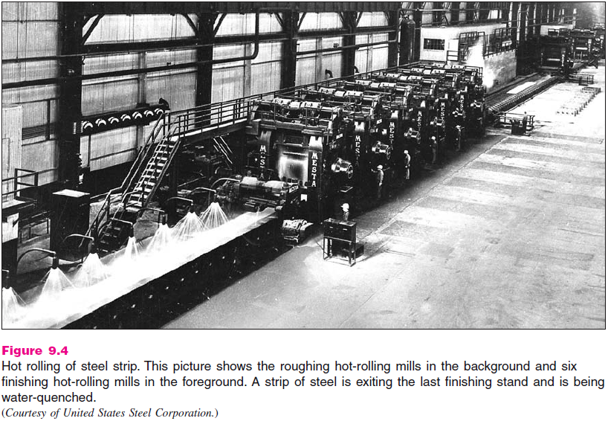
鋼片熱軋

Slide 9
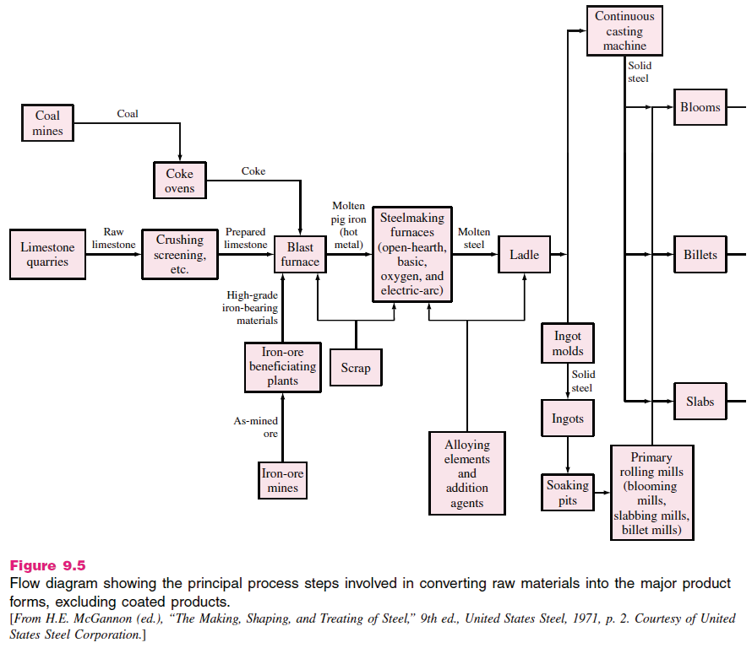
塊料
盛桶
鋼胚
板塊

Slide 10
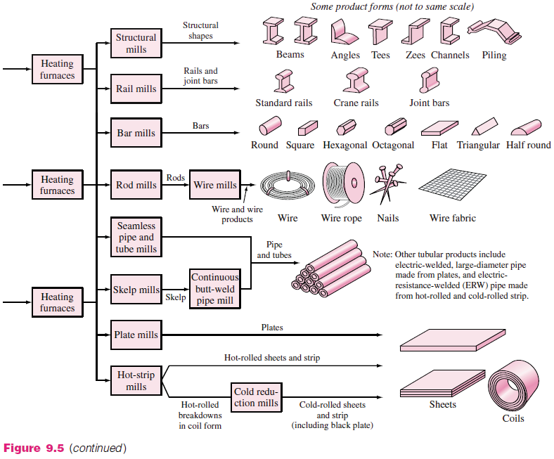

Slide 11
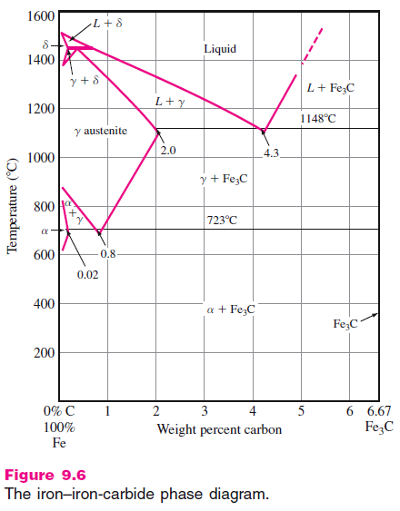
Iron Carbide Phase Diagram

Slide 12
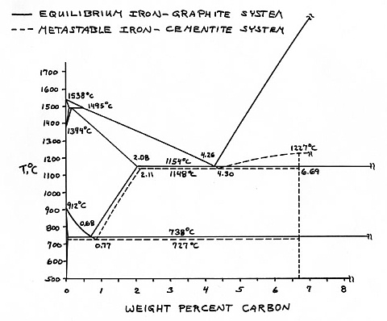
http://www.georgesbasement.com/Microstructures/CastIronsHighAlloySteelsSuperalloys/Lesson-1/Introduction.htm

Slide 13
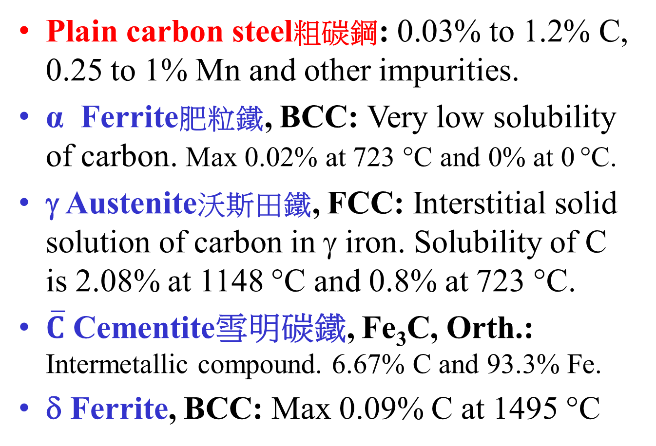
Iron Carbide Phase Diagram
Plain carbon steel粗碳鋼: 0.03% to 1.2% C, 0.25 to 1% Mn and other impurities.
α Ferrite肥粒鐵, BCC: Very low solubility of carbon. Max 0.02% at 723 °C and 0% at 0 °C.
γ Austenite沃斯田鐵, FCC: Interstitial solid solution of carbon in γ iron. Solubility of C is 2.08% at 1148 °C and 0.8% at 723 °C.
$\overline{C}$ Cementite雪明碳鐵, Fe₃C, Orth.: Intermetallic compound. 6.67% C and 93.3% Fe.
δ Ferrite, BCC: Max 0.09% C at 1495 °C

Slide 14
Invariant reactions 不變反應
Peritectic reaction包晶反應 :
Liquid (0.53%C) + δ (0.09%C) γ (0.17%C)
Eutectic reaction共晶反應 :
Liquid (4.3% C) γ austenite (2.08%C) + Fe₃C ( 6.67%C)
• Eutectoid reaction共析反應 :
γ Austenite (0.8%C) α Ferrite (0.02%C) + Fe₃C (6.67%C)
1495 °C
1148 °C
723 °C
Hypoeutectoid
Steel
0.8% C
Eutectoid Steel
Hypereutectoid
Steel
Less than 0.8% C
More than 0.8% C

Slide 15
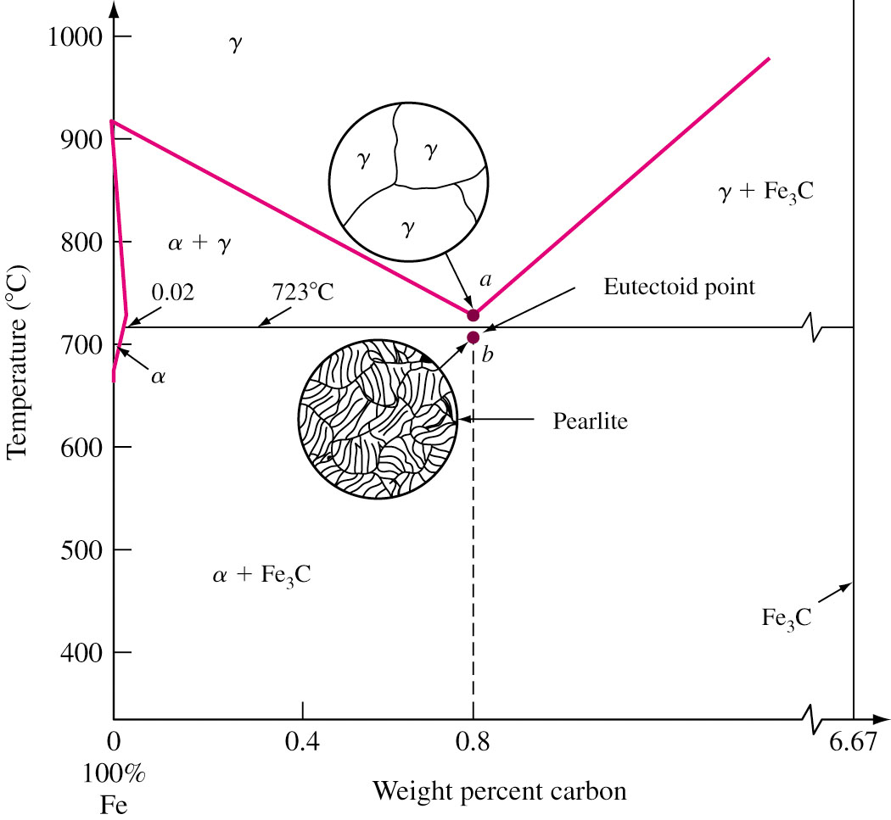
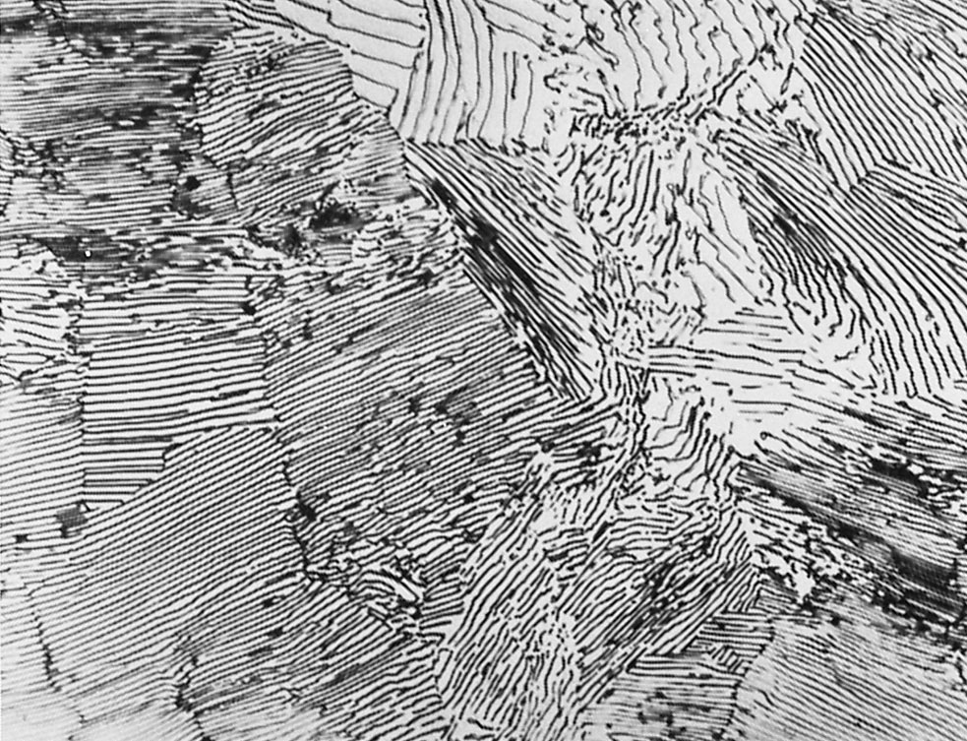
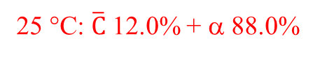
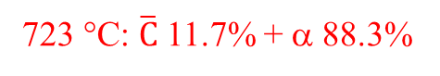
Slow Cooling of Plain Carbon Steel
Eutectoid plain carbon steel: If a sample is heated up to 750 °C and held for sufficient time, structure will become homogeneous austenite. (Austenitizing)
Below eutectoid temperature, layers of ferrite and cementite
are formed. Pearlite.
波來鐵
723 °C: $\overline{C}$ 11.7% + α 88.3%
20 μm
25 °C: $\overline{C}$ 12.0% + α 88.0%

Slide 16
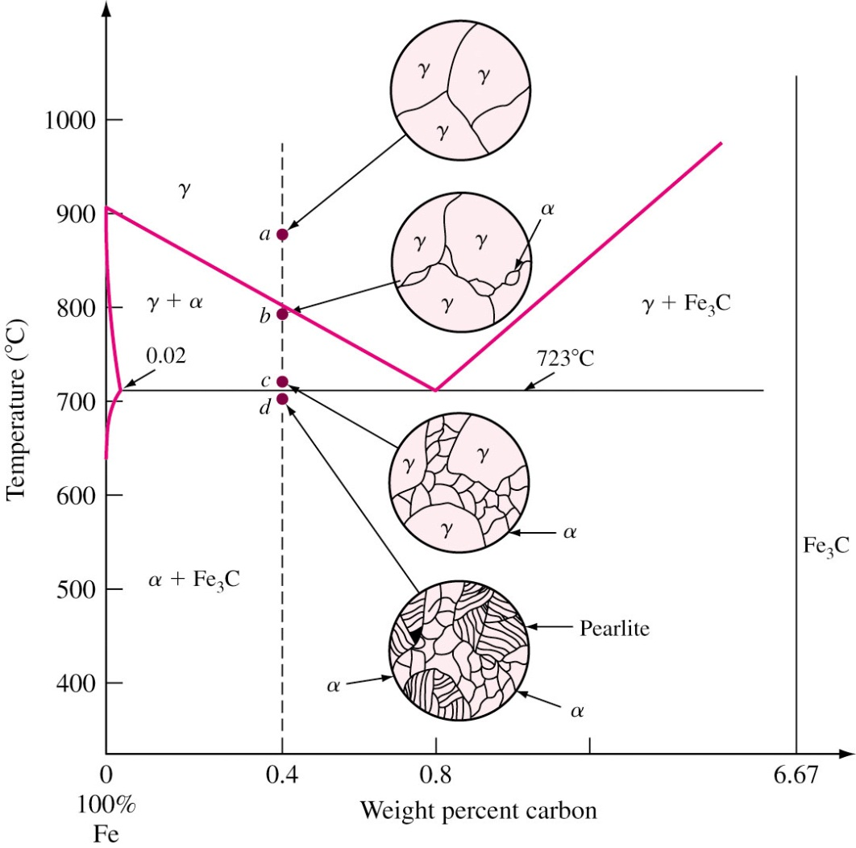
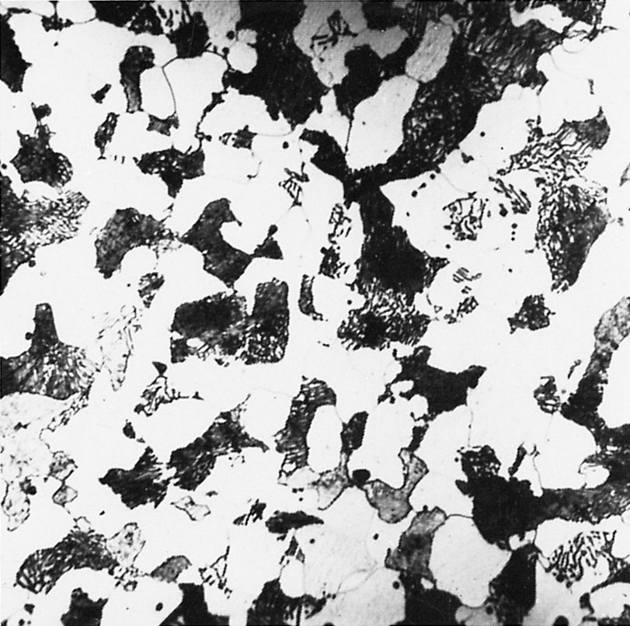
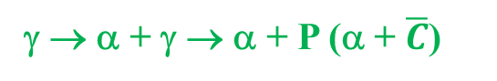
Slow Cooling of Plain Carbon Steel
Hypoeutectoid plain carbon steel: If a sample of 0.4% C is heated up to 900 °C, it gets austenitized.
Further cooling gives rise to α (51.3%) and pearlite.
Pearlite
γ → α + γ → α + P (α + $\overline{C}$)
α
α
Fe-0.35%C (58%α+42%P)

Slide 17
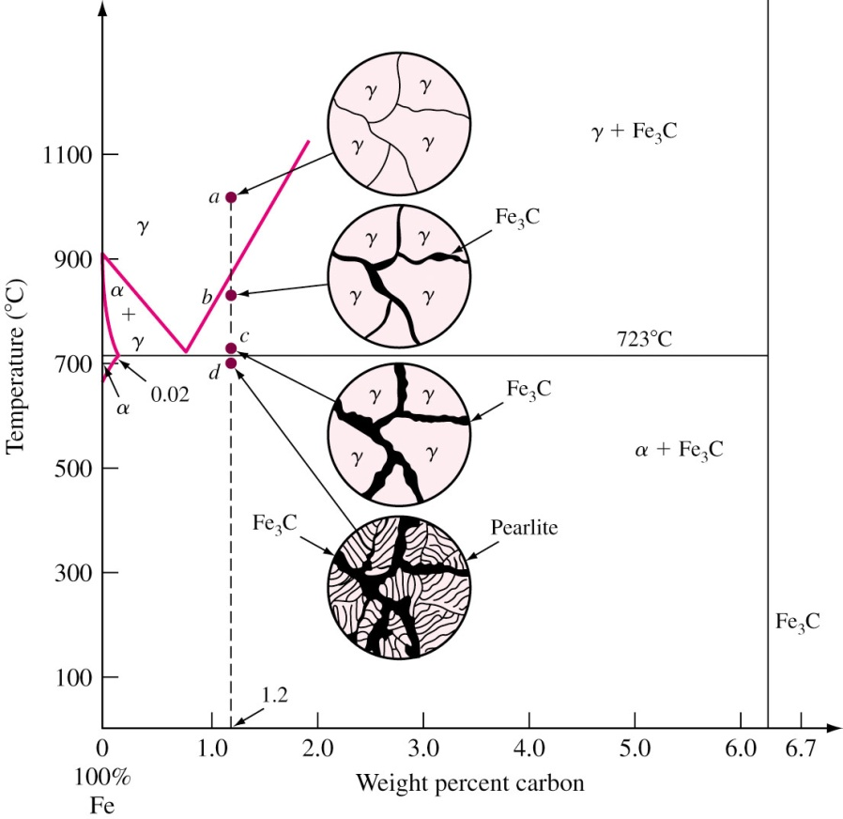

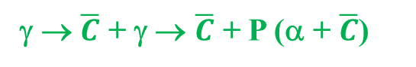
Slow Cooling of Plain Carbon Steel
Hypereutectoid plain carbon steel: If a 1.2% C sample is heated up to 950 °C and held for sufficient time, it entirely gets austenitized.
Further cooling results in proeutectoid cementite and pearlite.
γ → $\overline{C}$+ γ → $\overline{C}$ + P (α + $\overline{C}$)

Slide 18
Heat treatment of plain carbon steels
Heating and cooling properties of steels vary mechanical properties.
Martensite 麻田鐵 : Metastable phase consisting of supersaturated solid solution of C in BCC or BCT (tetragonal) iron.
Caused by rapid cooling of austenitic steel into room temperature (quenching 淬火).
M_{s}: temperature of martensite start.
M_{f}: temperature of martensite finish.

Slide 19
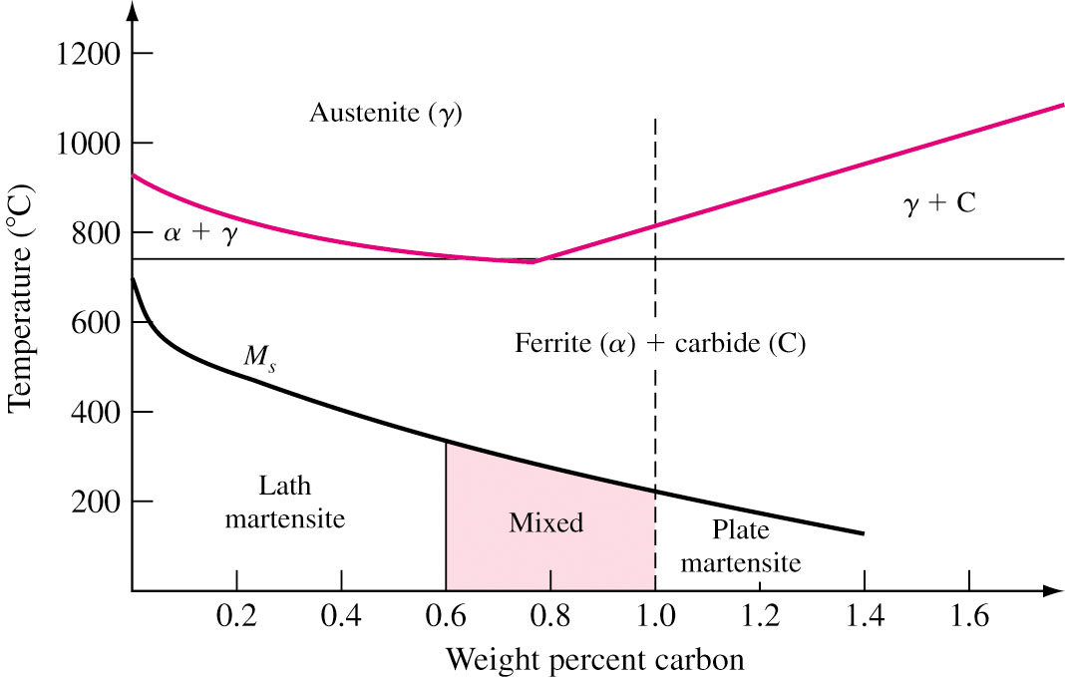
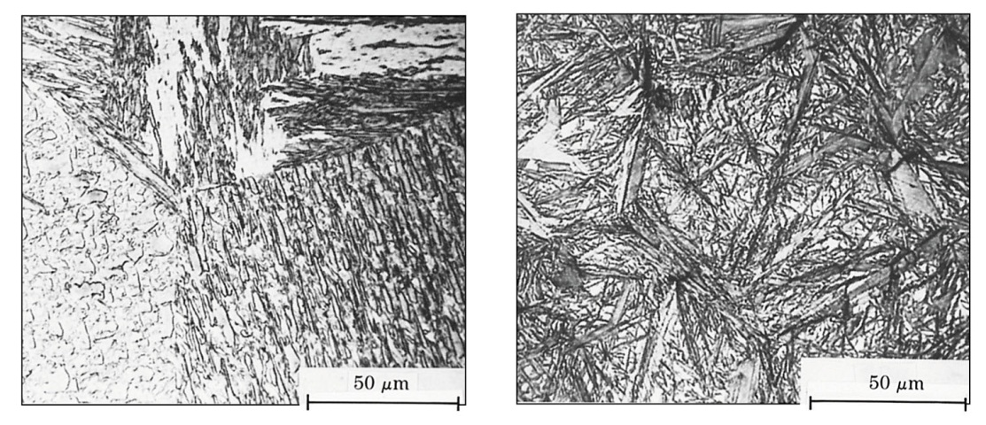
Microstructure of Fe–C Martensites
Lath板條 martensite: Less than 0.6% C and consists of domains of laths of different orientation.
Plate (lenticular透鏡) martensite: More than 0.6% C and have fine structure of parallel twins.
Lath type
Plate type
板條狀 Fe-0.2C
盤狀或 透鏡狀 Fe-1.2C

Slide 20
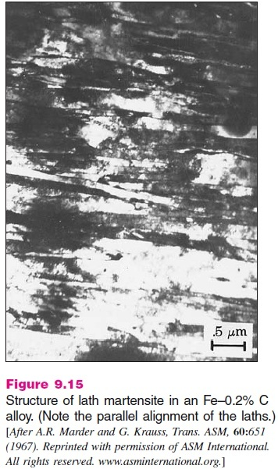
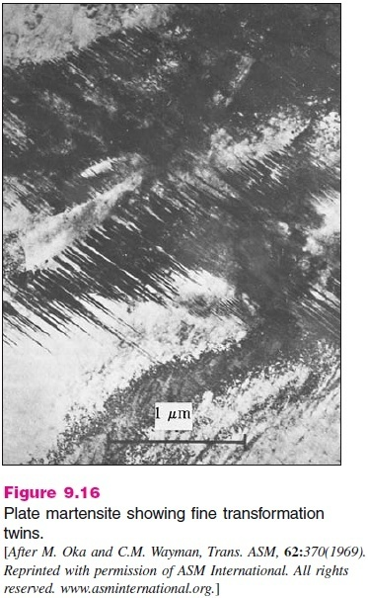
板條狀與透鏡狀麻田鐵

Slide 21
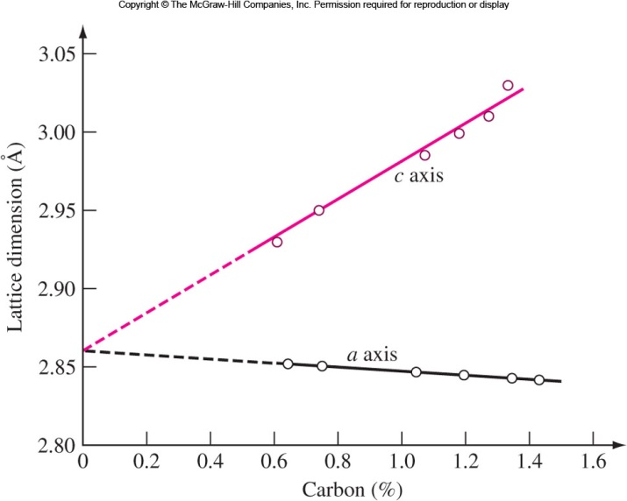
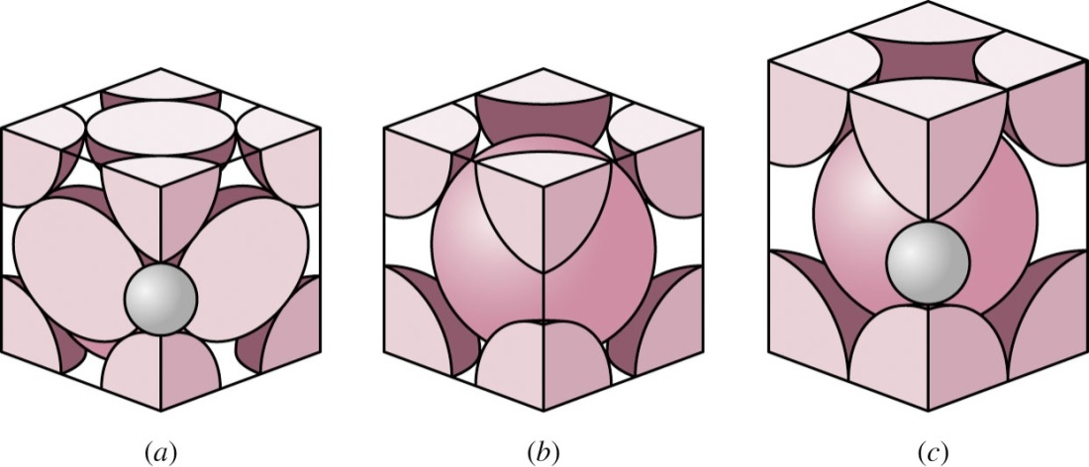
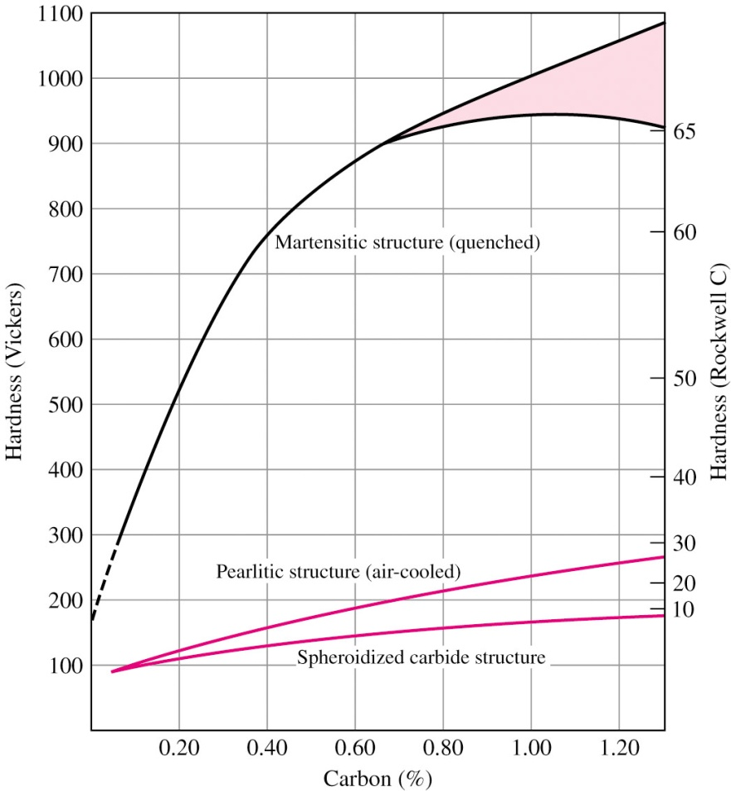
Martensite
Transfer to martensite is diffusionless.
No change of relative position of carbon atoms after transformation.
Strength and hardness increase with carbon content.
Strength is due to high dislocation concentration (or twinning) and inter- stitial solid solution strengthening.
FCC hole: 0.104 nm; BCC hole: 0.072 nm;
C: 0.154 nm

Slide 22
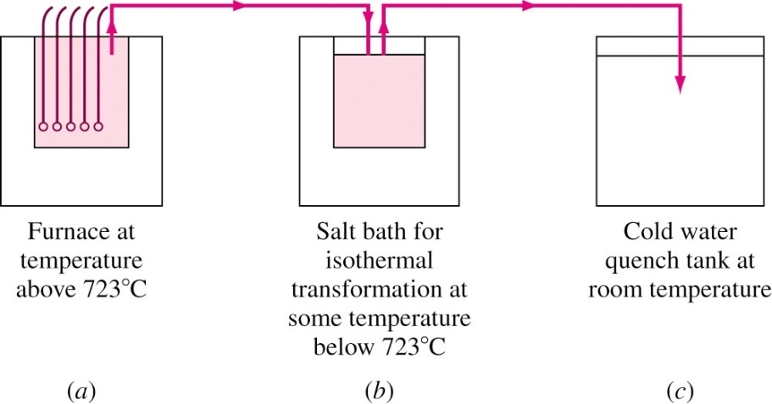
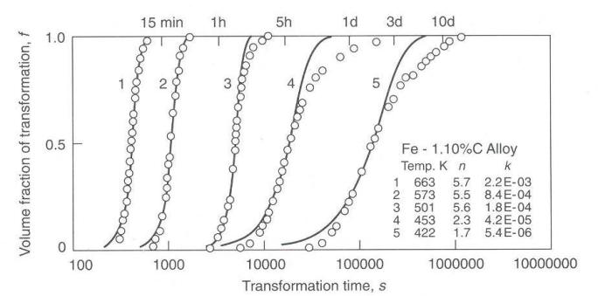
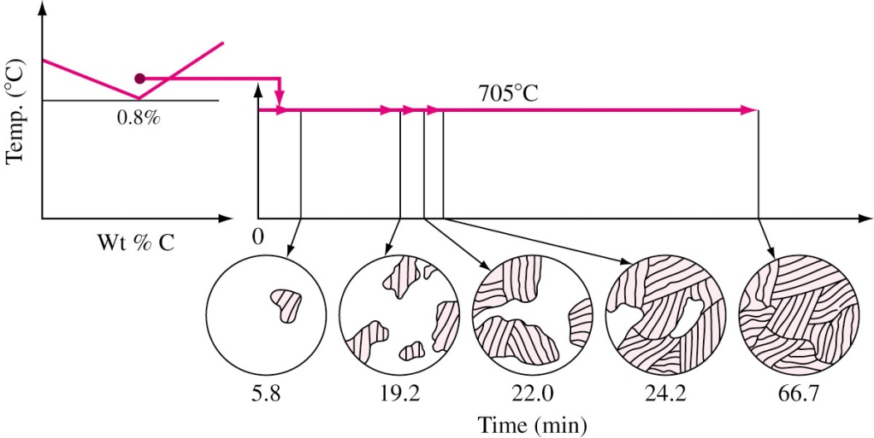
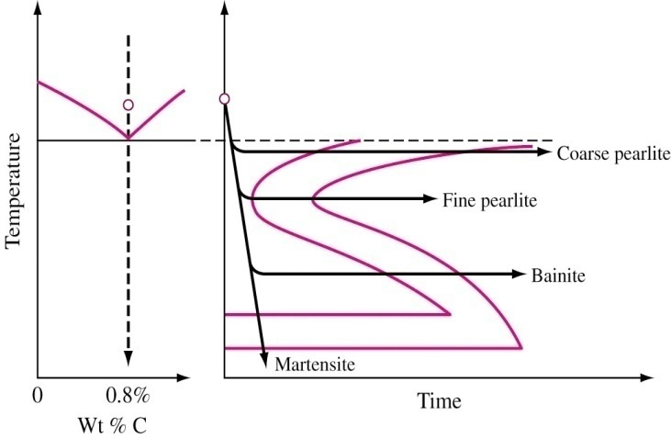
Isothermal Decomposition of Austenite
Several samples are first austenitized沃斯田化above eutectoid temperature in a salt bath 鹽浴and rapidly cooled to desired temperature in another salt bath and then quenched in water at various time intervals.
Repeat
procedure
at
progressive
lower
temperatures

Slide 23
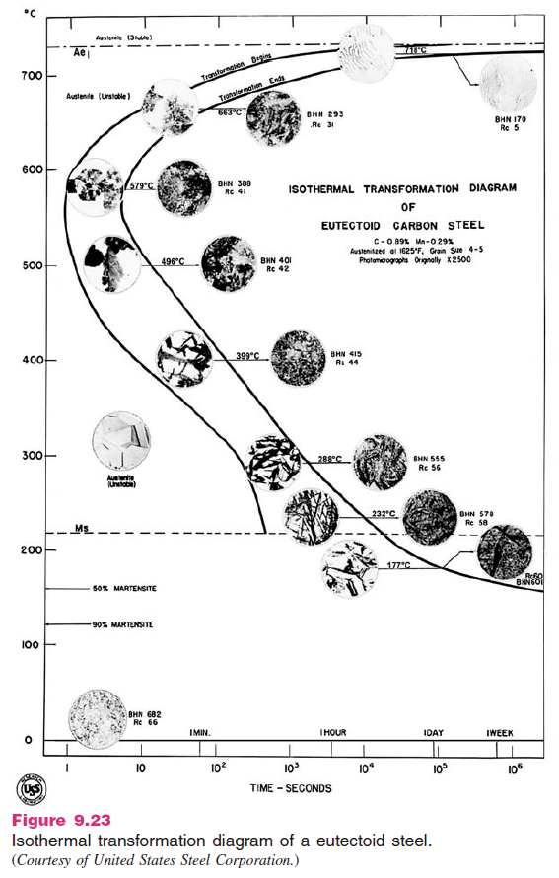

Slide 26
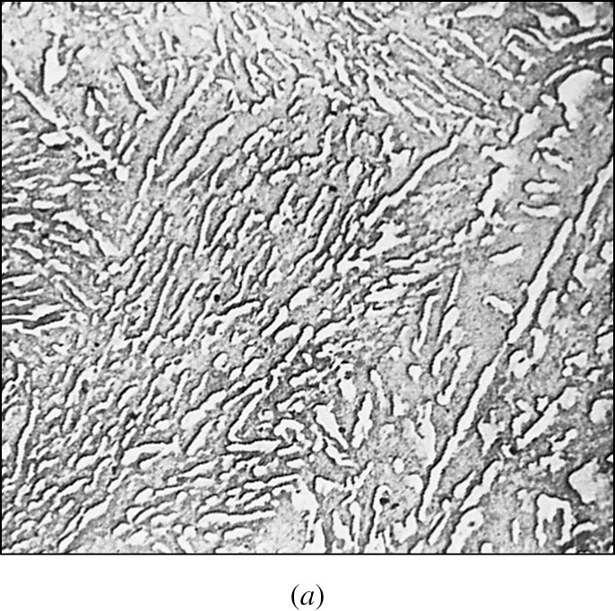
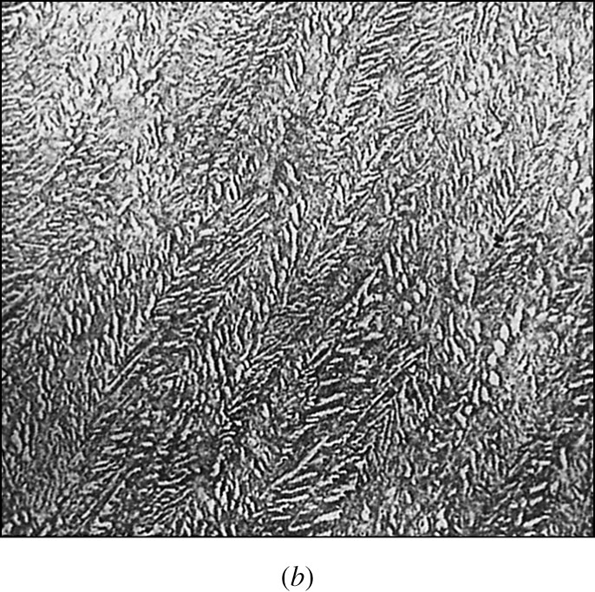
Isothermal decomposition of Austenite
If hot quenching temperature is between 550°C to 250°C, an intermediate structure Bainite變韌鐵 is produced.
Bainite contain nonlamellar eutectoid structure非層狀共析結構of α ferrite and cementite.
Upper Bainite Between 550°C and 350°C
Lower Bainite Between 350°C and 250°C
Upper Bainite
Lower Bainite

Slide 27
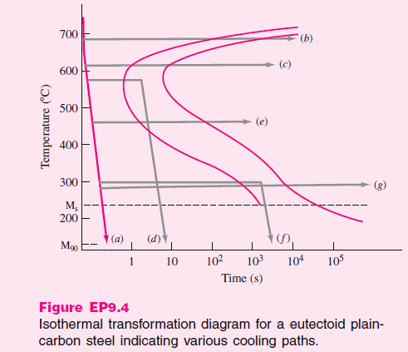
850 °C, 1 h, Homo.
30 min
3 min
1 h
690 °C, 2 h, W.Q.
Coarse P
610 °C, 3 min, W.Q.
Fine P
580 °C, 2 s, W.Q.
450 °C, 1 h, W.Q.
Upper B
W.Q.
300 °C, 30 min, W.Q.
300 °C, 5 h, W.Q.
Lower B
M
50% F P + 50% M
50% L B +50% M

Slide 28
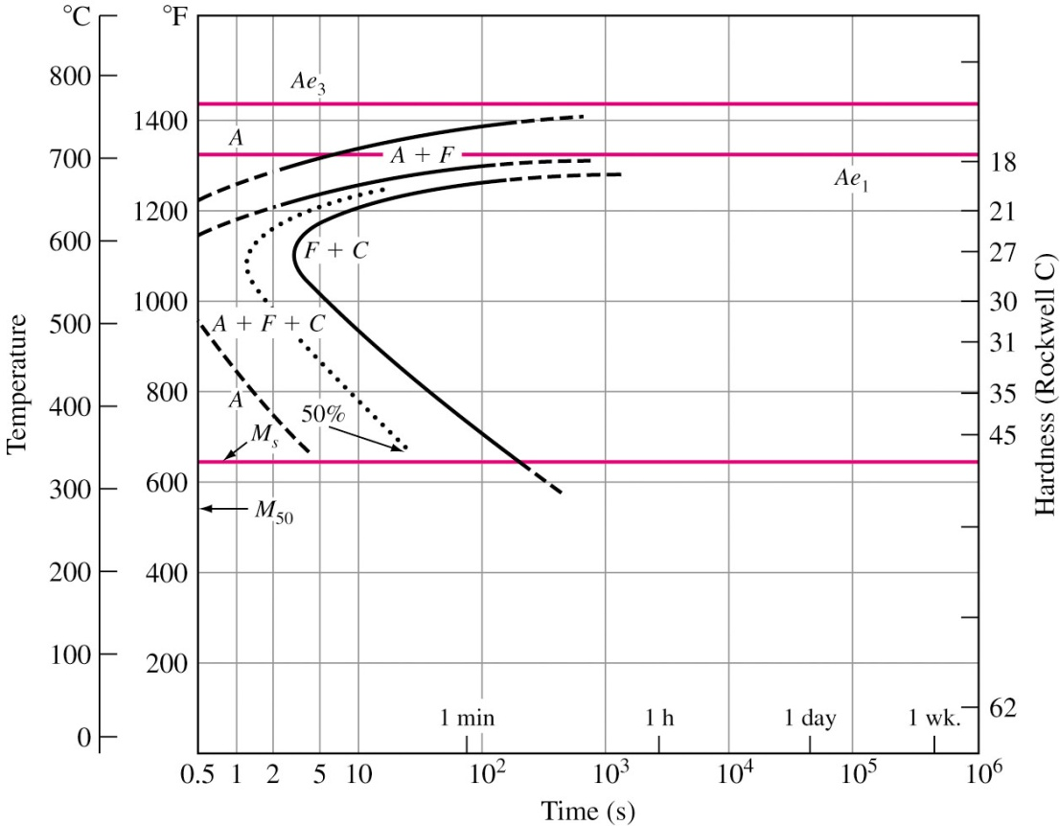
IT Diagrams for Noneutectoid Steels
“C” curves of IT diagrams of noneutectoid steel is shifted to left.
Not possible to quench from austenitic region to produce entirely martensite.
Additional transforma- tion line indicates start and formation of pro- eutectoid ferrite前共析 肥粒鐵.
Proeutectoid cementite for hypereutectoid steel.
765 °C
723 °C

Slide 29
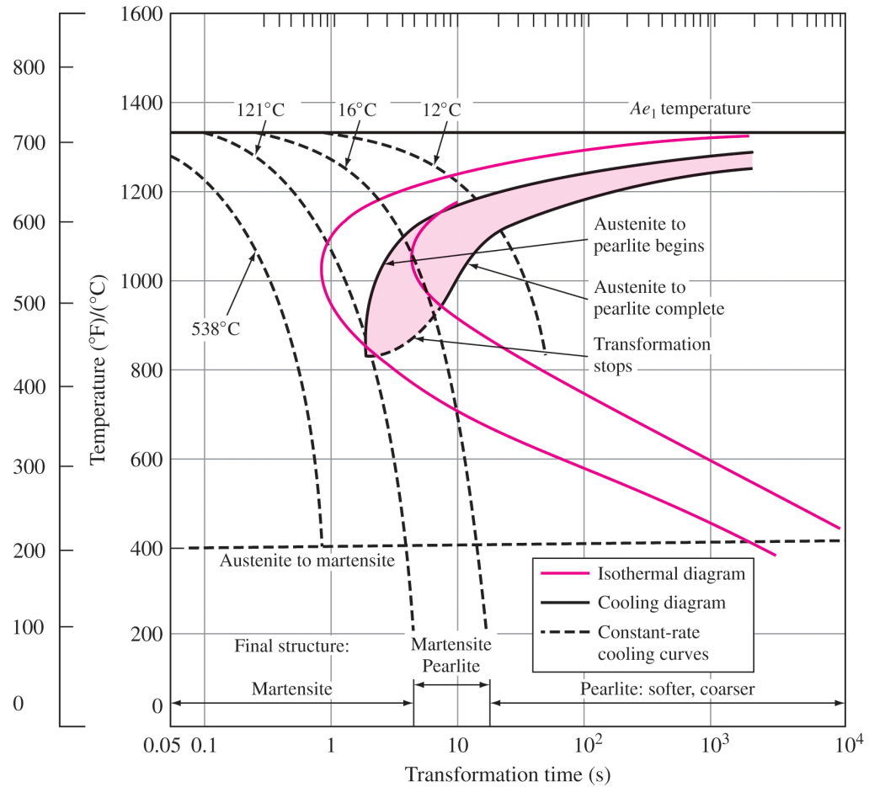
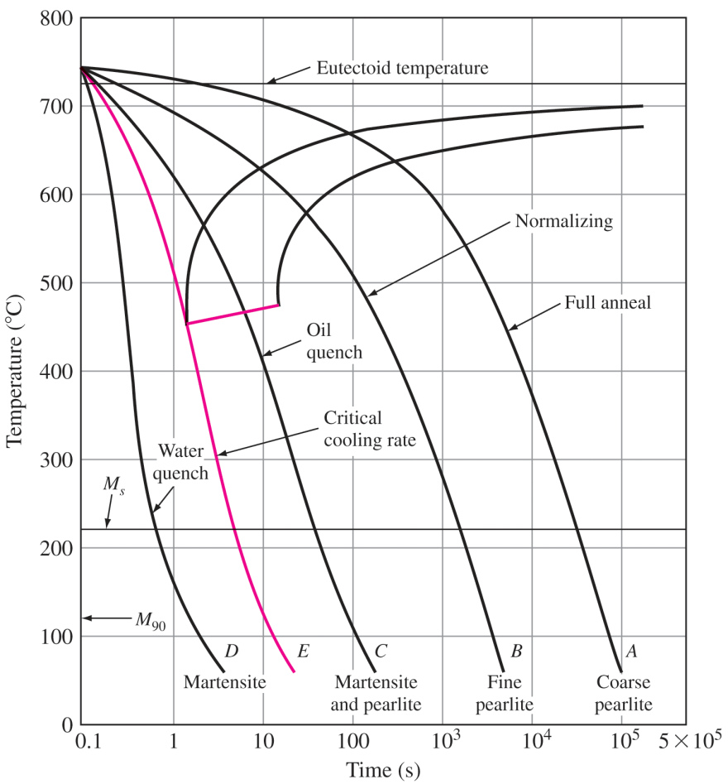
Continuous Cooling-Transformation Diagram
正常化
完全退火
538 °C/s
29
In continuous cooling transformation from martensite to pearlite takes place at a range of temperature.
Start and finish lines shifted to longer time.
No transformation (γ → B) below 450 °C.

Slide 30
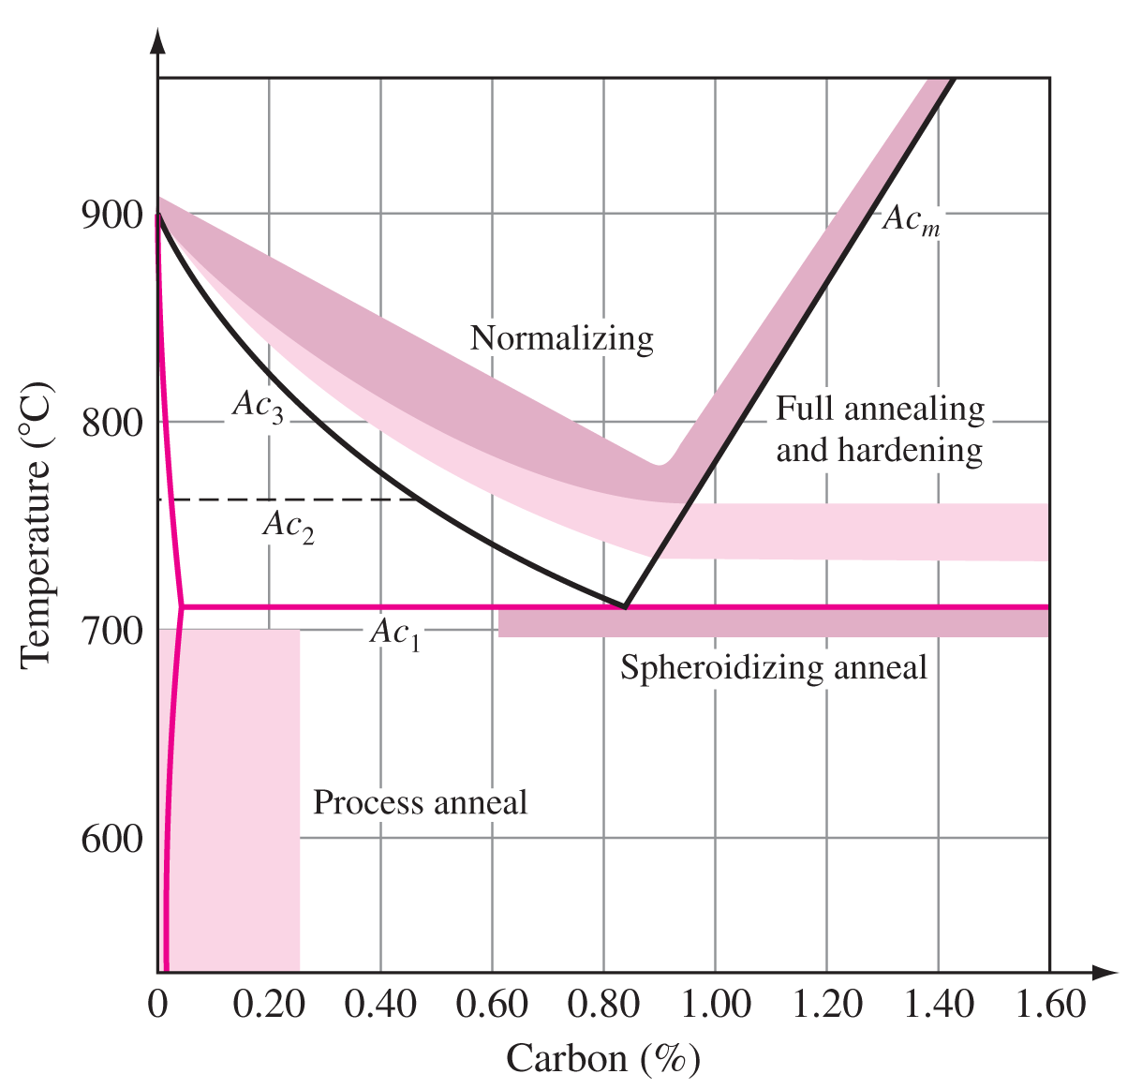
Annealing and Normalizing
Full annealing: Sample heated to 40°C above austenite ferrite boundary, held for necessary time and cooled slowly.
Process annealing 製程退火: Used for stress
relief. Applied to hypoeutectoid steel below eutectoid temperature, 550-650 °C.
Normalizing 正常化: Steel heated in austenite region and cooled in still air. Makes grain structure uniform, refines grain and increases strength.
30

Slide 31
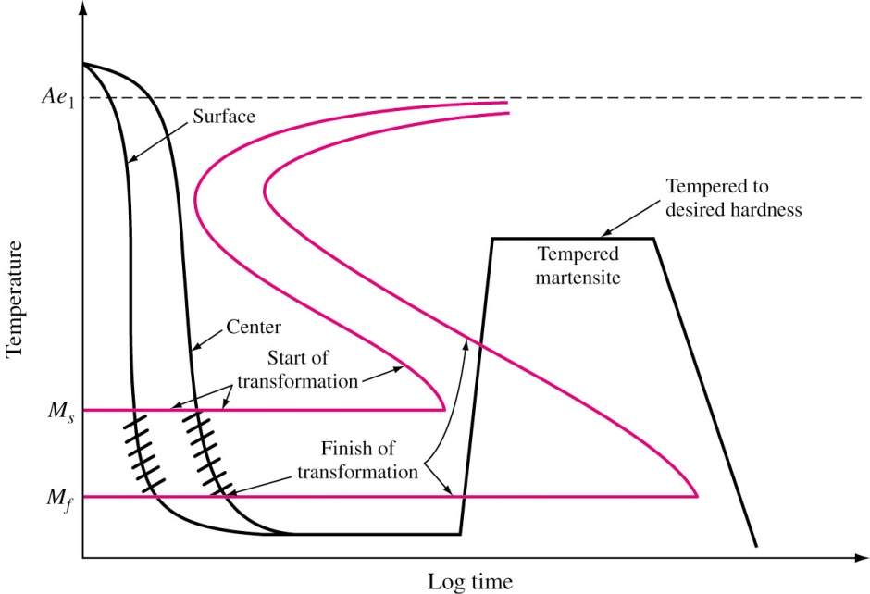
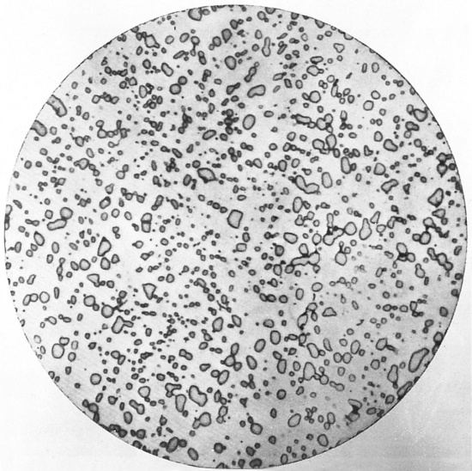
Tempering of Plain Carbon Steel
Martensitic steel is heated at a temperature below eutectoid temperature.
Makes steel softer and ductile.
Carbon atoms, in low carbon
steels, segregate themselves on
tempering 回火.
Tempering
Temperature
20 – 200 °C
Below 200 °C 200 – 700 °C
200 – 300 °C
400 – 700 °C
Structure
Carbon segregation
Epsilon Carbide
Cementite Cementite (rod-like)
Cementite (Spheroidite)

Slide 32
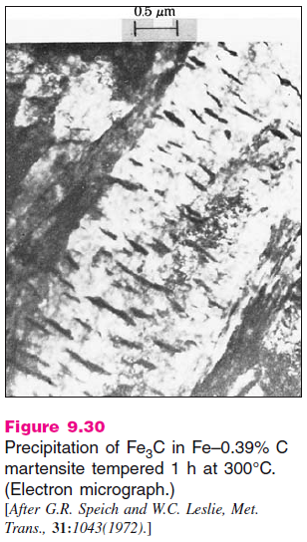
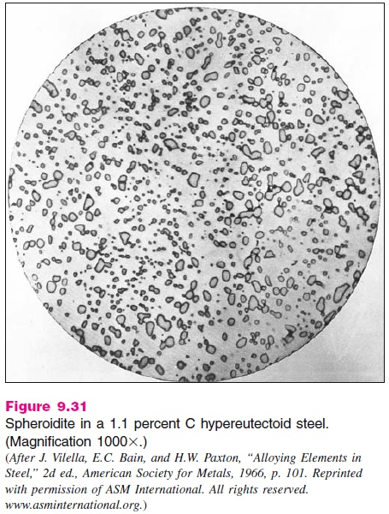
棒狀雪明碳鐵
球狀雪明碳鐵

Slide 33
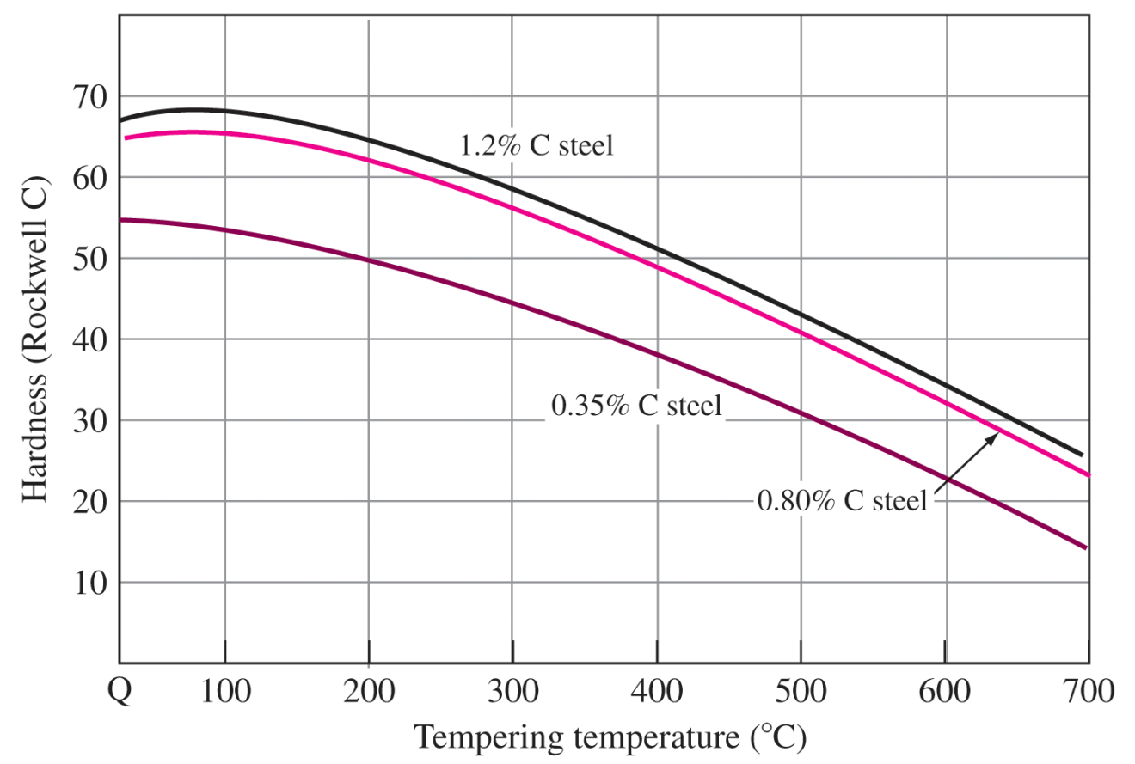
Effects of Tempering
Hardness decreases as temperature increases above 200 °C.
This is due to diffusion of carbon atoms from interstitial sites to iron carbide precipitates.
33

Slide 34
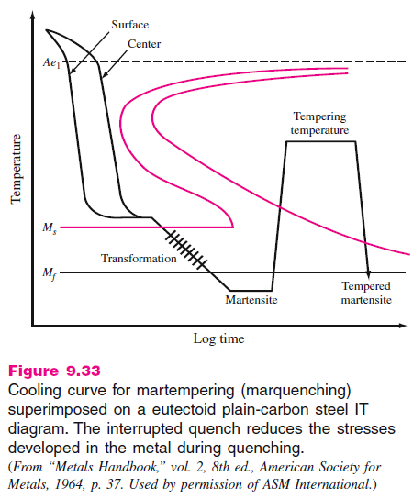
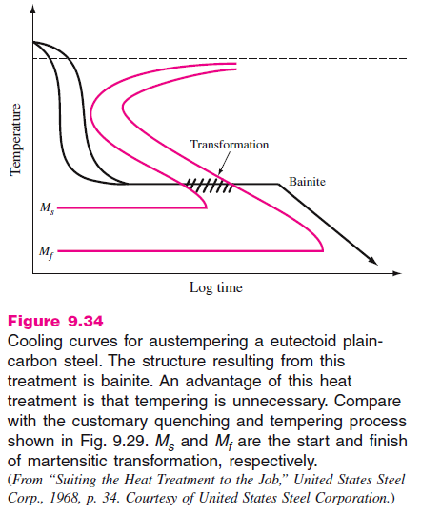
Martempering and Austempering
麻回火
沃斯回火

Slide 35
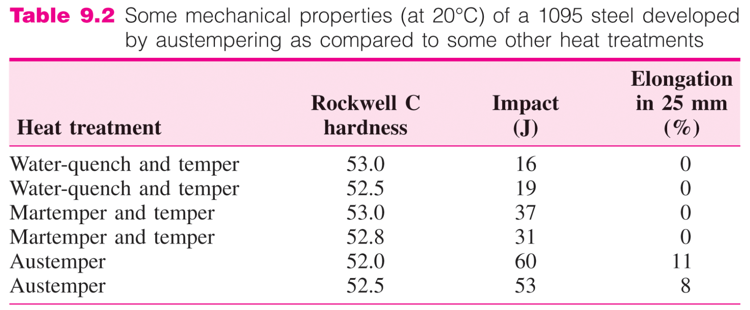
Martempering and Austempering
35
Martempering (Marquenching麻淬火): Austinitizing, quenching at around M_{s}, holding in quenching media until temperature is uniform, removing before Bainite forms and cooling at a moderate rate. Subsequently tempered.
Austempering: Same as martempering but held at quenching media till austenite to Bainite transformation takes place. 性質好、變形少；需特殊鹽浴、有限鋼種

Slide 36
Classification of Plain Carbon Steel
Four digit AISI-SAE code.
First two digits, 10, indicate plain carbon steel.
Last two digits indicate carbon content in 100th wt%.
Example: 1030 steel indicate plain carbon steel containing 0.30 wt% carbon.
Plain carbon steels: Fe-C-Mn-Si-P-S
As carbon content increase, steel becomes stronger and brittle.

Slide 37
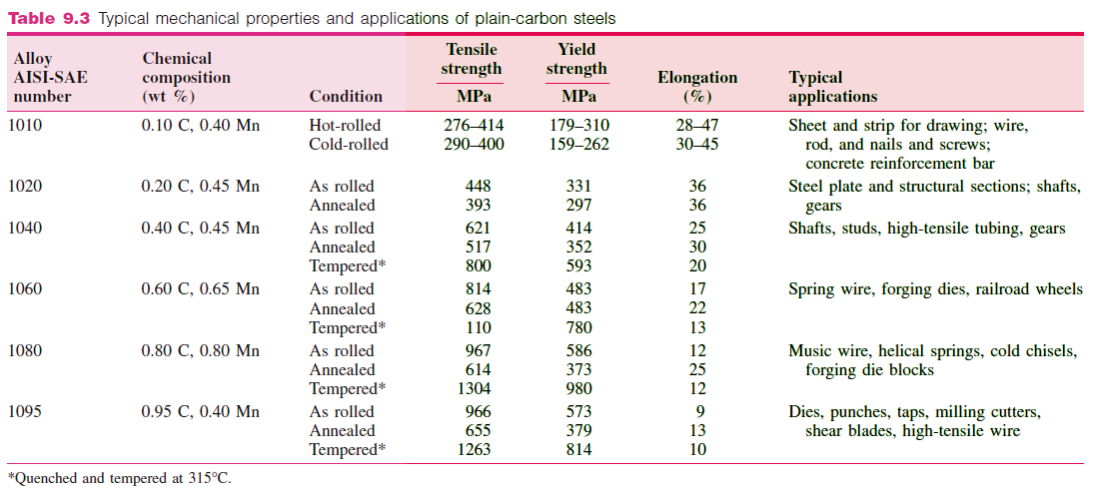
1100

Slide 38

Low Alloy Steels
Limitations of plain carbon steels:
Cannot be strengthened beyond 690 MPa without loosing ductility and impact strength.
Not deep hardenable.
Low corrosion resistance
Rapid quenching leads to crack and distortion.
Poor impact resistance at low temperature.
Alloy steels: Up to 50% alloying elements like manganese, nickel, chromium, molybdenum and tungsten. Others: V, Co, B, Cu, Al, Pb, Ti, Nb.

Slide 39
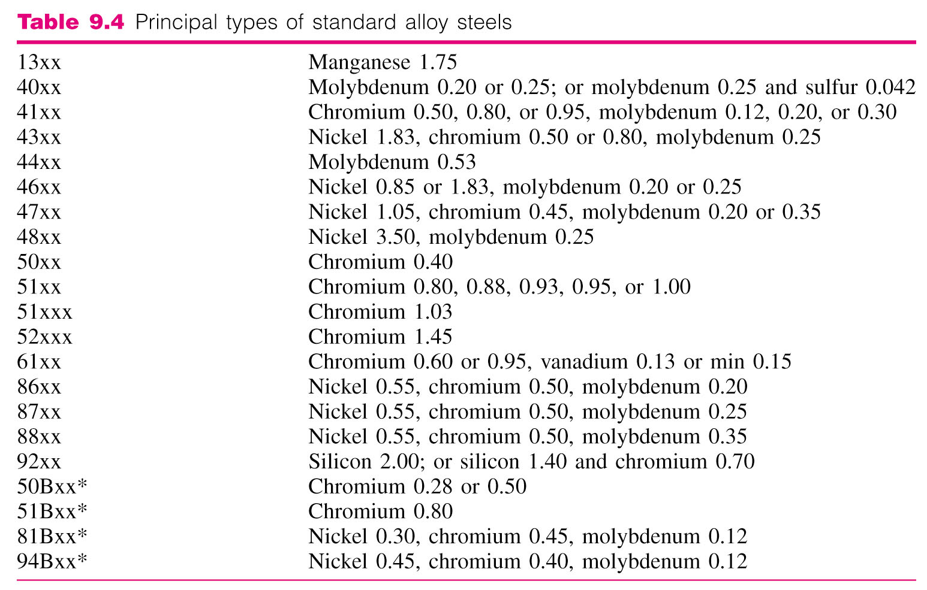
Classification of Alloy Steels
First two digits: Principle alloying element.
Last two digits: 100th wt% of carbon.

Slide 40
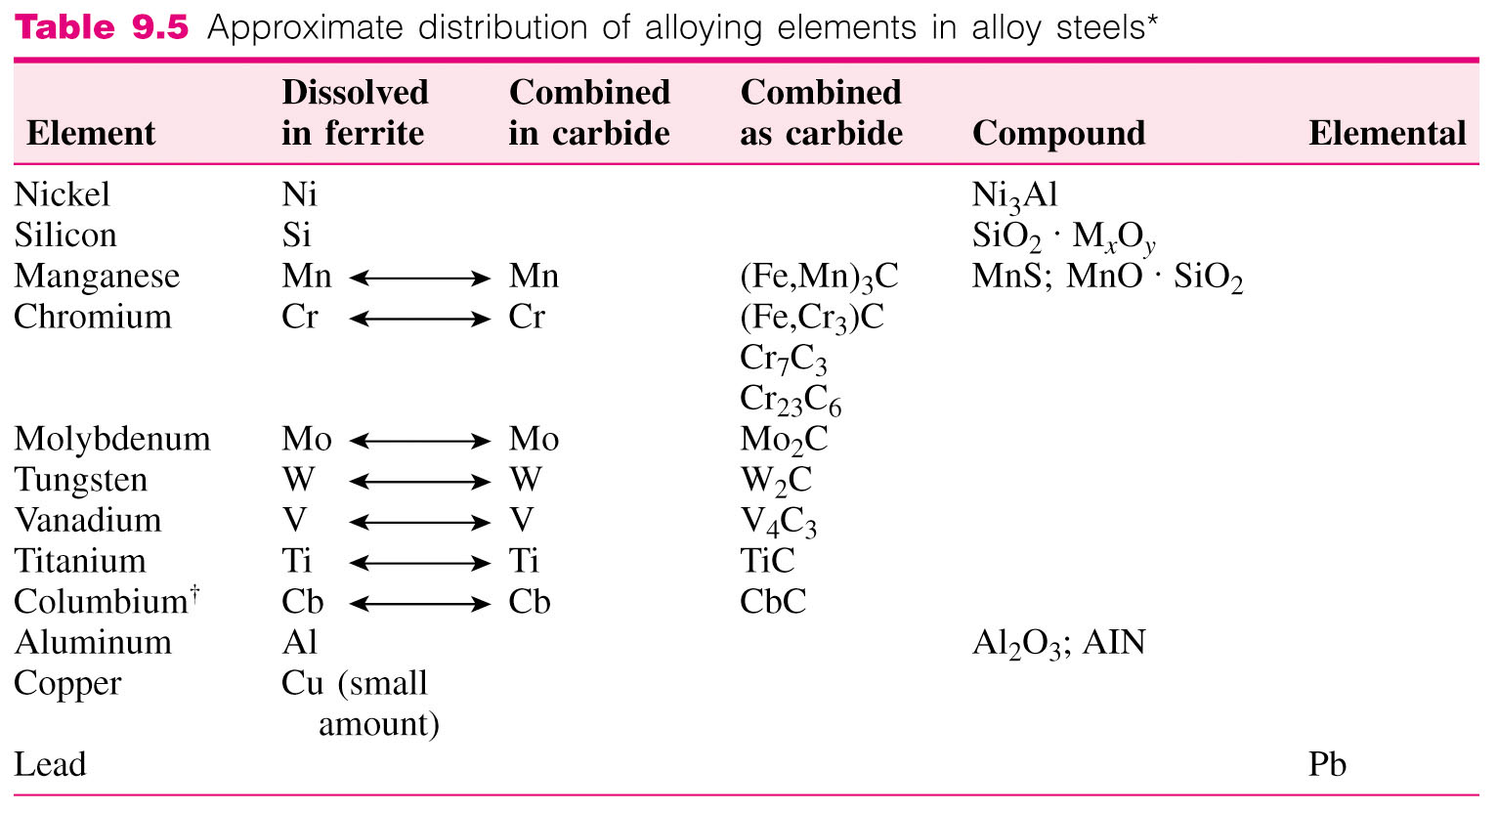
Distribution of Alloying Elements
Distribution depends upon compound and carbide forming tendency of each element.
(Fe,Cr)₃C
Carbide –forming tendency
Nb
AlN

Slide 41

Effects of Alloying Element on Eutectoid Temperature
41
Mn and Ni lower eutectoid temperature.
They act as austenite stabilizing element.
Tungsten, molybdenum
and titanium raise
eutectoid temperature.
They are called ferrite
stabilizing elements.

Slide 42
Hardenability
Hardenability硬化能 determines the depth and distribution of hardness induced by quenching.
Hardenability depends on
Composition
Austenitic grain size
Structure before quenching
Jominy hardenability test (Fig. 9.36)
Cylindrical bar (1 inch dia. and 4 inch length with 1/16 inch flange at one end) is austenitized and then one end is quenched.
After cooling, Rockwell C hardness is measured up to 2.5 inch from quenched end.
42

Slide 43


Slide 44

Hardenability Curve
For 1080 plain carbon steel, the hardness value at quenched end is HRC while it is 50 HRC at 4.5 mm (3/16”) from quenched end.
Alloy steel 4340 has high
hardenability and has
hardness of 40 HRC 2 inches
from quenched end.
In alloy steel, decomposition
of austenite to ferrite is delayed.
Cooling rate depends on bar dia.,
quenching media, and bar cross
section position.

Slide 45

4340: 0.40 C, 1.83 Ni, 0.80 Cr, 0.25 Mo 9840: 0.40 C, 1.00 Ni, 0.80 Cr, 0.25 Mo
4140: 0.40 C, 0.00 Ni, 0.80 Cr, 0.20 Mo
8640: 0.40 C, 0.55 Ni, 0.50 Cr, 0.20 Mo
5140: 0.40 C, 0.00 Ni, 0.80 Cr, 0.00 Mo

Slide 46

The T-T-T diagram for the 4340 alloy also shows distinct noses for the bainite and pearlite transitions. These move to longer times than the combined nose of a plane carbon steel.
https://www.princeton.edu/~maelabs/mae324/10/10mae_33.htm

Slide 47


Slide 48


Slide 49

43 HRC.
32 HRC.

Slide 50
43 HRC
32 HRC

Slide 51

Mechanical Properties of Low Alloy Steels
51

Slide 52
Mechanical Properties of Low Alloy Steels

Slide 53

Aluminum Alloys

Slide 54
Precipitation-strengthening Process
Precipitation Strengthening: Creates fine dispersion of precipitated particles in the metal and hinder dislocation movement.
Basic steps :
Solution heat treatment: Alloy sample heated to a temperature between solvus and solidus and soaked at that temperature.
Quenching: Sample then quenched to room temperature in water. Supersaturated SS.
Aging: Solutionized and quenched sample is then aged to form finely dispersed particles. Artificial aging vs. Nature aging.

Slide 55

Decomposition Products Created by Aging
Super saturated solid solution is in unstable condi- tion.
Alloy tends to seek a lower
energy state by decomposing
into metastable or equilibrium phase.
Supersaturated solid solution as highest energy state.
Equilibrium precipitate has lowest energy state.
GP zones

Slide 56

Effects of Aging on Strength
Aging curve: Plot of streng- th or hardness versus aging time.
As aging time increases alloy becomes strong- er, harder and less ductile.
Overaging decreases strength and hardness.

Slide 57
Example: Al-4% Cu Alloy
Al-4%Cu is solutionized at about 515 °C
Alloy is rapidly cooled in water.
Alloy is artificially aged in 130-190 °C
Structures formed :
GP1 Zone: At lower aging temperature, copper atom is segregated in supersaturated solid solution. 0.4-0.6 nm thickness, 8-10 nm diameter.
GP2 Zone (θ’’): Tetragonal structure, 1-4 nm thickness, 10-100 nm diameter (CuAl₂).
θ’ Phase: Tetragonal structure, 10-150 nm thickness nucleates heterogeneously on dislocation (CuAl₂).
θ Phase: Tetragonal structure, equilibrium phase, incoherent (CuAl₂).

Slide 58

GP zone, fcc; θ”(CuAl₂), Tetragonal, a = 4.04 Å, c = 7.8 Å; θ’(CuAl₂), Tetragonal, a = 4.06 Å, c = 5.8 Å;
θ(CuAl₂), Tetragonal, a = 6.07 Å, c = 4.87 Å.

Slide 59


Slide 60

GP zone, 130 °C, 16 h. 1,000,000×
GP2 zone (θ”) strain fields, 130 °C, 24 h.
800,000×
θ’, 200 °C, 72 h. 25,000×

Slide 61

Correlation of Structure and Hardness
GP1 and GP2 Zones increases hardness by stopping dislocation movement.
At 130 °C when θ’ forms, hardness is maximum.
After θ’ forms, GP2
zones are dissolved
and θ’ gets coarsened
reducing hardness.
GP2
θ’
GP1
GP2

Slide 62

General Properties of Aluminum
Low density, corrosion resistance.
High alloy strength (about 690 MPa)
Nontoxic and good electrical properties.
Production:
鋁礬土
Aluminum hydroxide is
precipitated from the aluminate solution.
Aluminum hydroxide is
thickened and calcined to
Al₂O₃ which is dissolve in
cryolite (Na₃AlF₆冰晶石） and electrolyzed.
Metallic aluminum sinks to bottom and is tapped out.
Aluminum
Ore (Bauxite)
Hot
NaOH
Sodium
Aluminate
+

Slide 63

Wrought Aluminum Alloys
Primary Fabrication: Usually semicontinuously cast by direct chill method.
Scalping刨皮: 12.5 mm metal is removed from hot rolled surface for good finishing.
Ingots are homogenized and rolled.
Classification: According to
major alloying elements.
Four digits: First digit -
major group of alloying
elements.
Second digit: Impurity limits.
Last 2 digits: Identify
aluminum alloy.

Slide 64


Casting in Industries
In industries, molten metal is cast into either semi finished or finished parts.
Direct-chill semicontinuous casting unit for aluminum
Large cast aluminum alloy ingot being removed from casting pit .

Slide 65

Cold Rolling (Cont..)
Initial metal thickness – Final metal thickness
% Cold work =
x 100
Initial metal thickness

Slide 66

Cold Rolling of Metal Sheet
Cold rolling is rolling performed below recrystallization temperature.
This results in strain hardening.
Hot rolled slabs have to
be annealed before cold
rolling.
Series of 4 high rolling
mills are usually used.
Less reduction of
thickness.
Needs high power.

Slide 67
Temper Designations
Temper designations are designated by hyphen.
Example: 2024-T6
T1 – Naturally aged
T3 – Solution heat treated.
T4 – Solution heat treated
and naturally aged.
T5 - Cooled and artificially
aged.
T6 - Solution heat treated
and artificially aged.
T7 - Solution heat treated
and stabilized.
T8 - Solution heat treated,
cold worked and then
artificially aged.
H1 – Strain hardened
alloy. H12, H14, H16, H18
H2 – Strain hardened
and partially
annealed. H22, H24, H26, H28
H3 - Strain hardened
an annealed. H32, H34, H36, H8
F – as fabricated
O – Annealed
H – Strain hardened.
T – Heat treated to
produce stable
temper
H38

Slide 68

TX 之細分符號及其意義
CNS 2068 鋁、鎂及其合金之鍊度符號 98年11月9日修訂公布

Slide 69
Non Heat Treatable Aluminum Alloys
1xxx alloys : 99% Al + Fe + Si + 0.12% Cu
Tensile strength (1100 annealed) = 90 MPa
Used for sheet metals
3xxx alloys : Manganese is principle alloying element.
Al 3003 = Al 1100 + 1.25% Mn
Tensile strength = 110 MPa
General purpose alloy
5xxx alloys: Al + up to 5% Mg
Al 5052 = Al + 2.5%Mg + 0.2% Cr
Tensile strength = 193 MPa
Used in bus, truck and marine sheet metals.

Slide 70


Slide 71
Heat Treatable Aluminum Alloys
2xxx alloys: Al + Cu + Mg Al2024 = Al + 4.5% Cu + 1.5% Mg +0.6%Mn Strength = 442 MPa Used for aircraft structures.
6xxx alloys: Al + Mg + Si Al6061 = Al + 1% Mg + 0.6%Si + 0.3% Cu + 0.2% Cr Strength = 290 MPa Used for general purpose structure.
7xxx alloys: A + Zn + Mg + Cu Al7075 = Al + 5.6% Zn + 2.5% Mg + 1.6% Cu + 0.25% Cr Strength = 504 MPa Used for aircraft structures.

Slide 72
Aluminum Casting
Sand Casting: Simple and used for small quantities and complex jobs.
Permanent mold casting: Molten metal is poured into permanent metal mold.
Finer grain structure and strength due to fast cooling.
Less shrinkage and porosity.
Small size and simple parts only.
Die casting: Molten metal forced into molds under pressure.
Almost finished parts, automatic.
Good tolerance and surface finish.
Fine grain structure.

Slide 73

砂心
上模
下模
砂箱

Slide 74



Permanent-Mold Casting
Casting mold
Cast parts
Cast parts
Casting Process

Slide 75

Aluminum Casting Alloy Compositions
Composition of casting alloys differs greatly from wrought alloys.
Casting properties and mechanical properties are of primary interest.
Denoted as 4 digits with a period between last two digits.

Slide 76
Copper Alloys
General properties of copper: Good electrical and thermal conduction, ease of fabrication, corrosion resistance, medium strength.
Production of copper:
Copper sulfide (+FeS) concentrates are smelted.
Copper sulfide is converted to blister copper 粗銅 (>98% Cu) by blowing air through matte.
Impurities in blister copper removed as slag in refining furnace tough pitch copper.
Tough pitch copper韌煉銅 is further refined electrolytically (>99.95% Cu).

Slide 77

Classification of Copper Alloys
Numbers C10100 to C79900 designate wrought alloys.
Numbers C80000 to C99900 designate casting alloys.

Slide 78

98 Cu
91 Cu

Slide 79
98 Cu
88 Cu

Slide 80

Unalloyed Copper
Electrolytic tough pitch copper is least expensive and used in production of wire, rod, and strip.
Has 0.04% oxygen.
Cu₂O + H₂ 2Cu + H₂O
H₂O causes inner holes and
blisters.
Copper cast in controlled
reducing atmosphere
Heated
400 °C
Oxygen free high conductive
Copper
(Alloy C10200--99.95%Cu)

Slide 81


Copper Zinc Alloys
Copper forms substitutional solid solution with Zn till 35% Zn.
Cartridge brass 70% Cu & 30% Zn single phase
Muntz brass 60% Cu & 40% Zn two phase.
Lead (0.5 to 3%) is always added to some Cu-Zn brasses to increase machinability.
Alpha
Beta
Figure 9.53

Slide 82

易切黃銅

Slide 83
Other Copper Alloys
Copper-Tin Bronzes: 1 to 10% tin with Cu to form solid solution strengthened alloys.
Stronger and less corrosive than Cu-Zn bronzes.
Up to 16% Sn is added to alloys that are used for high strength bearings.
Copper beryllium alloys: 0.6 to 2% Be and 0.2 – 2.5 % Cobalt with copper.
Can be heat treated and cold worked to produce very strong (1463 MPa) bronzes.
Excellent corrosion resistance and fatigue properties.
Used in nonsparking tools, springs, diaphragms, valves etc.

Slide 84

Stainless Steel
Excellent corrosion resistance in stainless steel is due to high (at least 12%) Chromium forming chromium oxide on surface.
Ferrite stainless steel :
12-30% Cr
Structure is mainly
ferritic (BCC α ).
Cr extends α region
suppresses γ region
forming γ loop.
Low cost high strength (517 MPa) and hence used in construction materials.
Curie T
84

Slide 85

(Worked hardening)
(1280)
(970)
(Worked hardening)
(760)
(520)

Slide 86



Slide 87
Martensitic Stainless Steel
12–17% Cr and 0.15–1% C.
Martensite formed from quenching from austenite region.
Poor corrosion resistance.
Heat treatment: Same as plain carbon steel.
Tensile strength: 517 MPa to 1966 MPa.
Used for machine parts, pumps, bearings, and valve parts.
When carbon content is greater than 1%, γ loop is enlarged.

Slide 88
Austenitic Region
Iron-Chromium (16-25%) – Nickel (7-20%) ternary alloy.
Austenitic structure (FCC γ ) remains austenitic at all temperature due to nickel.
Better corrosion resistance than other steels.
Tensile strength 559-759 MPa.
Used for chemical equipment, pressure vessels etc.
Alloying element, Nb or Ti, prevents intergranular corrosion if the alloy is to be used for welding. 870-600 °C.

Slide 89


Slide 90
Cast Iron
General Properties: Contains 2-4% Carbon and 1-3% Si.
Easily melted, very fluid, low shrinkage, easily machinable, high strength and hardness, wear and corrosion resistance.
Low impact resistance and ductility.
Types of Cast Iron:
White cast iron白鑄鐵
Gray cast iron灰鑄鐵
Malleable cast iron展性鑄鐵
Ductile cast iron延性鑄鐵

Slide 91


Slide 92

UTS ksi
YS ksi, Elon. %
UTS ksi, YS ksi, Elon. %

Slide 93

White Cast Iron
Much of carbon forms Iron Carbide instead of graphite up on solidification.
Fractured surface appears white and crystalline.
Low carbon (2.5 – 3%) and silicon (0.5 – 1.5%) content.
Excellent wear resistance.
Iron Carbide
Pearlite

Slide 94


Gray Cast Iron
Carbon exceeds the amount that can dissolve in austenite and precipitate as graphite flakes.
Fractured surface appears gray.
Excellent machinability, hardness and wear resistance, and vibration damping capacity.
2.5 – 4% C and 1 – 3% Si (Promotes formation of graphite).
Graphite
Flakes

Slide 95

Ductile Cast iron
Has processing advantages of cast iron and engineering advantages of steel.
Good fluidity, castability, machinability, and wear resistance.
High strength, toughness, ductility, and hardenability (due to spherical nodules of graphite).
3-4% C and 1.8 – 2.8 % Si and low impurities (0.03%S, 0.1%P).
Bull’s eye type microstructure.
加Mg反應掉S, O，促進球化

Slide 96



Slide 97


Slide 98

Malleable Cast Iron
2-2.6 % C and 1.1 – 1.6% Si.
White cast iron is heated in malleablizing furnace to dislocate carbide into graphite.
Irregular nodules of graphite are formed.
Good castability, machinability, moderate strength, toughness and uniformity.
After “Metals Handbook,” vol. 7, 8th ed., American Society for Metals, 1972, p.95.

Slide 99
Heat Treatment
Heat treatment of white irons to produce malleable irons are
Graphitization: Castings heated above the eutectoid temperature (940 °C) and held for 3 to 20 h depending on the composition and structure.
white iron graphite and austenite.
Cooling :
Ferritic malleable iron: Fast cooled to 740-760 °C and then slowly cooled at 3-11 °C/s.
Pearlitic malleable iron: Slowly cooled up to 870 °C and then air cooled.
Tempered martensitic malleable iron: Casting cooled in furnace to a quenching temperature and homogenized (845-870 °C, 15-30 min) and quenched in agitated oil and then 590-725 °C tempering.

Slide 100
Magnesium, Titanium and Nickel Alloys
Magnesium Alloys:
Low density metal, high cost, low castability, low strength, poor creep, fatigue and wear resistance.
Two types: wrought alloys (sheet, plate, extrusion) and casting alloys (casting).
Designated by two capital letters and two or three numbers.
First two letters indicate two major alloying elements.
The numbers indicate wt% of alloying elements.

Slide 101

A: Al; E: Rare earth; H: Thorium, Th; K: Zr Q: Ag; Z: Zn; M: Mn; S: Si; T: Sn; HK31: Mg-3%Th-1%Zr AZ91: Mg-9%Al-1%Zn
調質(Temper)符號與鋁合金所用者相同
05/2011, Al 80 NTD/kg, Cu 135 NTD/kg, SS: 134 NTD/kg, 鋼筋 22 NTD/kg, Mg 91NTD/kg.
05/2015, Al 56 NTD/kg, Cu 420 NTD/kg, SS: 75 NTD/kg, 鋼筋 14 NTD/kg, Ni 418 NTD/kg.

Slide 102
Structure and Properties of Magnesium Alloys
Limited cold working due to HCP structure.
Usually hot worked.
Al, Zn increase strength (Mg₁₇Al₁₂). Th, Zr increase high temp. strength.
Alloying with rare earth elements (cerium) produces rigid boundary network.
Tensile strength 179–310 MPa.
Elongation – 2 to 11%

Slide 103


Slide 104

71
α
α
Ti-6Al-4V α+β
Heat treatment
1173
1035
7

Slide 105
Titanium Alloys
Low density and high strength.
Expensive – used for aircraft applications.
Superior corrosion resistance.
Special technique needed to work with metal.
HCP at room temperature. Transforms to BCC at 883 °C.
Al and O increase transformation temperature. V and Mo decrease transformation temperature.
Tensile strength – 662 to 862 MPa
Ti-6Al-4V: 1173 MPa (UTS)

Slide 106
Nickel Alloys
Expensive, good corrosion resistance and high formability.
Commercial Nickel and Monel alloys: good weldability, electrical conductivity and corrosion resistance.
Nickel + 32% Cu Monel alloy (strengthens nickel).
Nickel based superalloys: High temperature creep resistance and oxidizing resistance for gas turbine parts.
50-60% Ni + 15-20% Cr + 15-20% Co + 1-4% Al + 2-4% Ti.
3 phases – Gamma austenite, gamma prime (Ni₃Al, Ni₃Ti, high temperature strength and stability), carbide particles（0.01-0.04％ C, grain boundary stability).

Slide 107

Grain boundary carbide
γ’ precipitates
γ matrix

Slide 108
Intermetallics
Unique combination of properties.
Examples: Nickel aluminide
Iron aluminide
Titanium aluminide
Low density, good high temperature strength, less corrosion but brittle.
0.1 % Boron and 6-9 % Cr added to reduce embrittlement and to increase ductility.
Applications: Jet engine, pistons, furnace parts, magnetic applications (Fe₃Si) and electronic applications (MoSi₂).
High temperature
applications

Slide 109
Shape Memory Alloys (SMA)
SMA recover predefined shape when subjected to appropriate heat treatment.
Recovers strain and exerts forces.
Examples: AuCd, Cu-Zn-Al, Cu-Al-Ni, Ni-Ti
Processed using hot and cold forming techniques and heat treated at 500-800 °C at desired shape.
At high temperature – Regular cubic microstructure (Austenite)
After cooling – Highly twinned platelets (Martensite)

Slide 110
Shape Memory Effect
SMA easily deformed in martensite state due to twin boundaries and deformation is not recovered after load is removed.
Heating causes Martensite Austenite transformation so shape is recovered.
Effect takes place over a range of temperature.
母相
麻田相
麻田相變形
回復母相
Ni
Ti

Slide 111


Slide 112



Slide 113

SMA - Hysterisis
Heating and cooling temperatures do not overlap – Exhibits hysterisis
Applied stress may deform and transform SMA to martensite – stress induced transformation
Shape is recovered when stress is released
Nitonol (NiTi) is commonly used SMA
Shape memory strain of 8.5%
Non-magnetic, corrosion resistant
Applications: Vascular stents, coffeepot thermostats, eyeglass frames, orthodontics wire, vibration damper & surgical tools.

Slide 114
形狀記憶合金
形狀記憶效應
超彈性現象
一般材料
SIM
應力
應力
SIM回復
10%
溫度
應變
應變
A_{s}
A_{f}

Slide 115


Slide 116


Amorphous Metals
Atoms arranged in random manner in metals under special circumstances
Produced by rapid quenching (10⁵ K/s) – No time to form crystals.
Till now only small pieces could be produced
No dislocation activity: Very hard, perfectly plastic, high dimensional accuracy (no shrinkage)
Prof. Inoue
Bulk AM- Zr-based
Applications:
Surgical knives
Golf clubs
crystalline
Amorphous

Slide 117

High Entropy Alloys 高熵合金
1995年葉均蔚教授發明，2004年第一篇HEA期刊論文 Adv. Eng. Mater. 6 (2004) 299
HEA定義：5個元素以上，每個不超過35 at%。G = H − ST 不同於鋼鐵、鋁合金、銅合金
結構：FCC 或 BCC + ppt
性質：強、硬、韌、耐溫等
應用：渦輪引擎、耐溫建築、模具、超低溫、耐磨塗層等
XZ Lim, Nature 533 (2016) 306.
ICHEM 2016, November 6th – 10th 2016, NTHU, Taiwan

Slide 118
Summary
Engineering alloys: Ferrous (steel and cast iron) and Nonferrous
Cast irons: low cost, good castability. Five irons: white, gray, malleable, ductile, and high-alloy cast irons.
Steels (Fe + C + Si + Mn + P + S + Ni + Cr + Mo + W + V…):
Carbon steels: low, medium, high carbon steels. Quenching and tempering. IT and CCT curves. Microstructures: ferrite, cementite, pearlite, bainite, martensite, tempered martensite
Low-alloy steels: good combinations of high strength and toughness. Applications: shafts, axles, gears, springs…
High-alloy steels: Stainless steels (> 12% Cr): corrosion resistance. Three types: ferritic, martensitic, austenitic.
Aluminum alloys: Lightness, conductivity, workability.
Copper alloys: conductivity, strength, corrosion resistance.
Others: Magnesium, Titanium, Nickel alloys.

